Slide 1
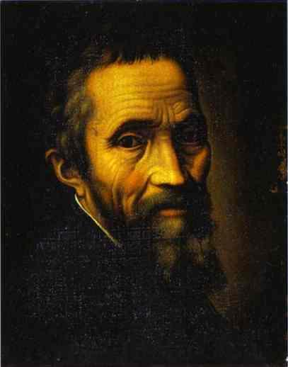
Michelangelo Buonarroti 1475-1564

Slide 2
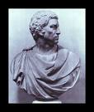
Michelangelo’s Biography
Born March 6,1475 near Florence, Italy.
By age 13 he had already became a pupil under the great sculpture Donatello.
After a year in his apprenticeship he accepted an invitation from Lorenzo de Medici who became his patron.
Michelangelo was a sculptor, painter and architect.
In 1564 he died at the age of 89.

Slide 3
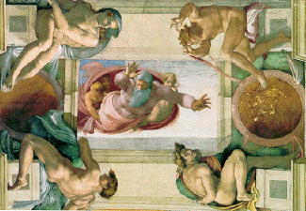
Michelangelo painted using fresco. This means painting on wet plaster

Slide 4
The Sistine Chapel
The Sistine Chapel is in Rome.
Michelangelo was asked by the Pope (Julius the second) to repaint the ceiling of the Sistine Chapel.
It contains more than 300 figures-not one of them look alike.
The painting depicts 9 scenes from the Bible including The Last Judgment and frescoes of Moses and Christ
Michelangelo worked for four years painting upside down on a scaffold!

Slide 5
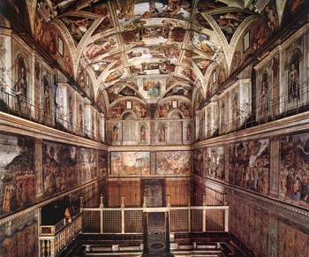
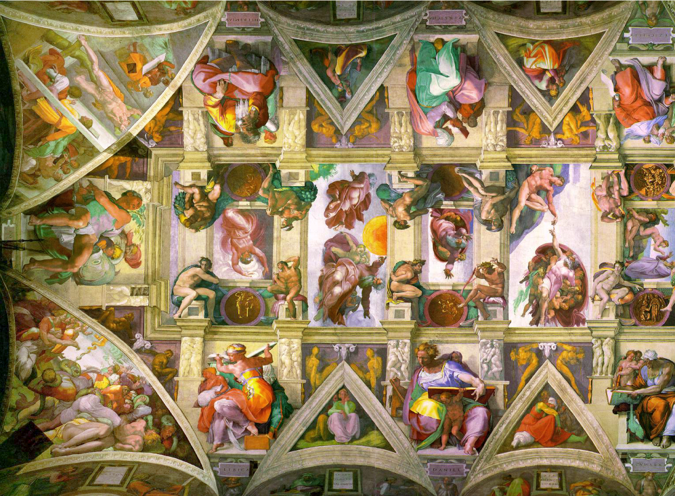

Slide 6
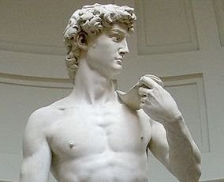
Sculptures
Michelangelo had many other works.
The Piéta was made of marble and is the only sculpture he ever signed.
He created it when he was 24 years old.
He also had many other sculptors including David, his most famous work.

Slide 7
