Slide 1
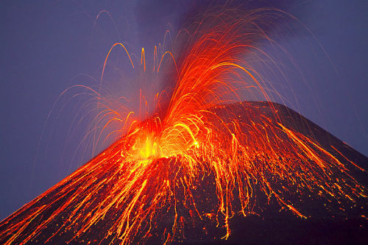
POMPEII
The Eruption of
Mount VESUVIUS

Slide 2
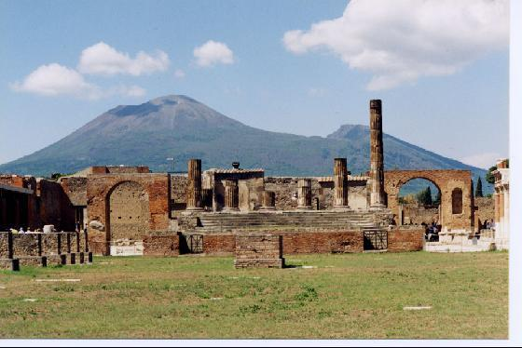
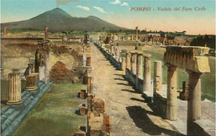
Pompeii was a Roman city that was built near Mount Vesuvius.
In the year A.D. 79 Mount Vesuvius erupted and buried Pompeii and many of its Roman citizens under a 9 metre thick layer of burning hot ash.

Slide 3
The remains of Pompeii have been excavated (dug out) by archaeologists to show us what the Roman city originally looked like, 2,000 years ago, and how Romans lived their lives.

Slide 4
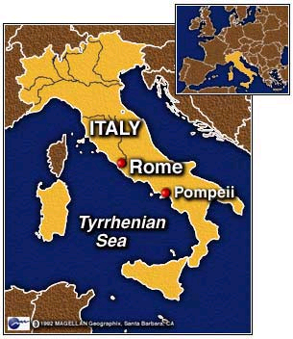

Slide 5
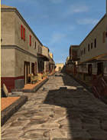
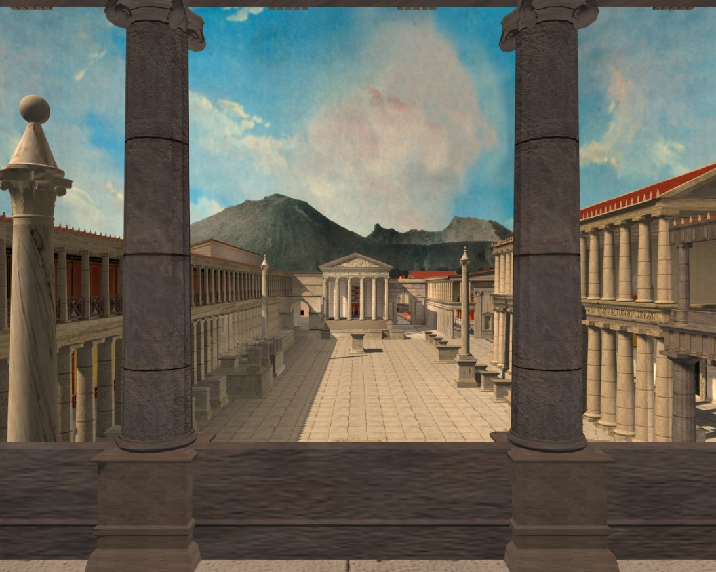
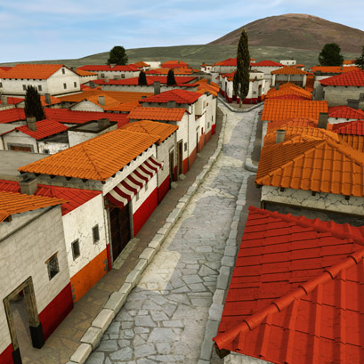
This is what Pompeii may have looked like before the eruption of Mount Vesuvius!

Slide 6
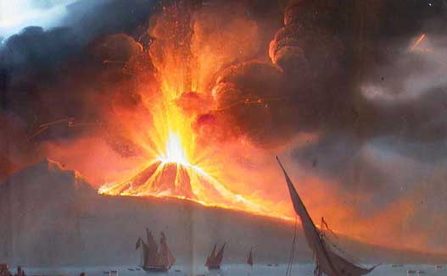
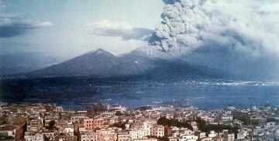
On 24th August (AD 79) Mount Vesuvius erupted. It threw rock, ash and lava up into the sky!

Slide 7
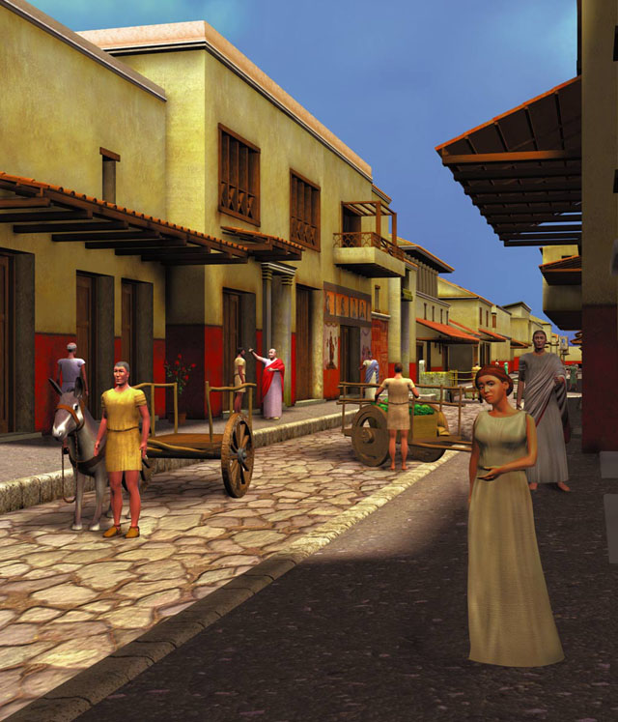
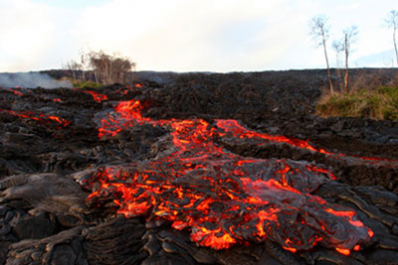
Lava flowed down the side of the mountain but the people of Pompeii didn’t think the eruption would last long or that it would reach the city.

Slide 8
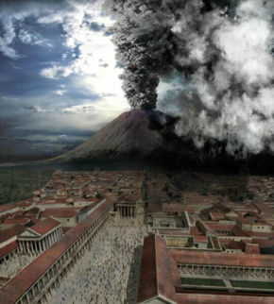
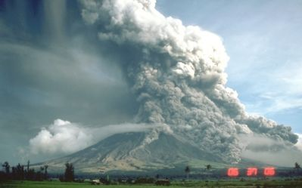
18 hours later there was an even bigger explosion-it blew half the side of the mountain off!
A huge cloud of ash, rock and gas raced down the mountain towards Pompeii.
People tried to outrun the cloud but it was too fast.

Slide 9
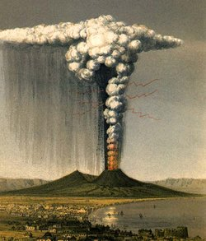
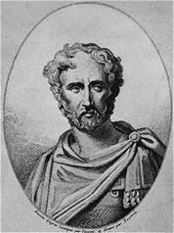
A Roman called Pliny who witnessed the eruption tried to rescue some of the people from Pompeii but he died from breathing in the hot ash and gas.
Pliny

Slide 10
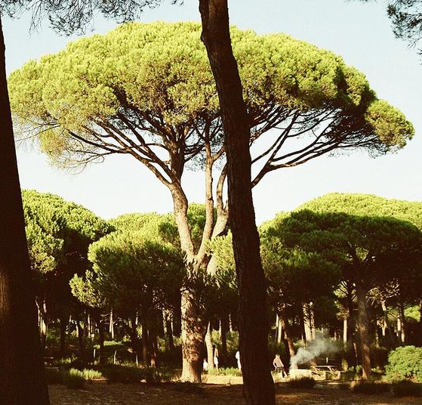
This is what Pliny wrote about the eruption:
“I cannot give you a more exact description of its appearance than by comparing to a stone pine tree; for it shot up to a great height in the form of a tall trunk, which spread out at the top as though into branches. ... Occasionally it was brighter, occasionally darker and spotted, as it was either more or less filled with earth and cinders.”
Why do you think he said the cloud was like a stone pine tree?

Slide 11
When the side of the mountain blew off, the citizens of Pompeii could not escape.
The citizens of Pompeii and their city were buried in seconds beneath a layer of ash and rocks 9 metres thick.

Slide 12
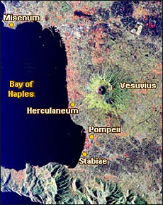

Slide 13
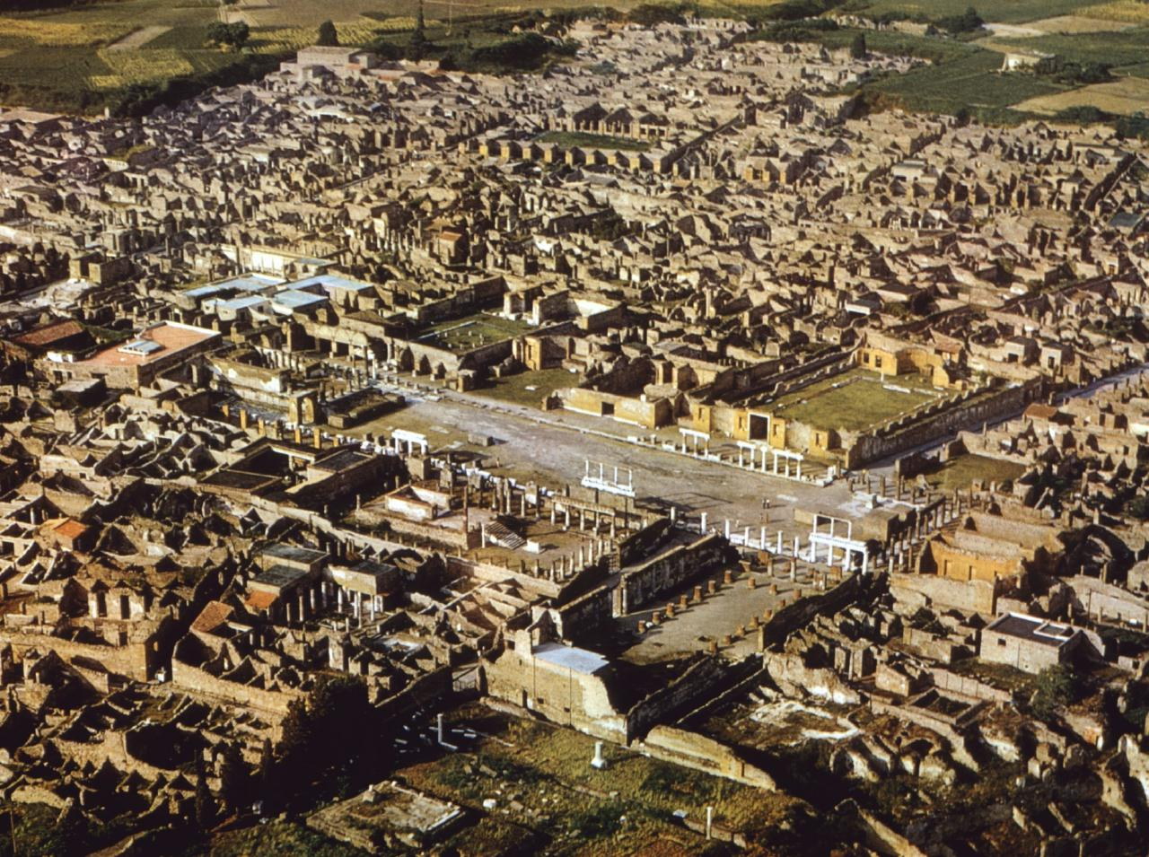
Archaeologists discovered Pompeii nearly 2000 years later!

Slide 14
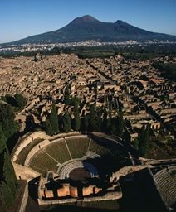
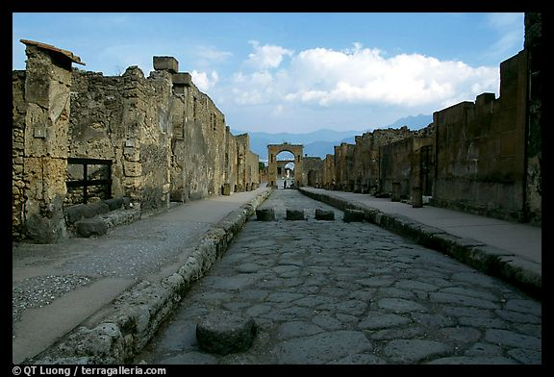
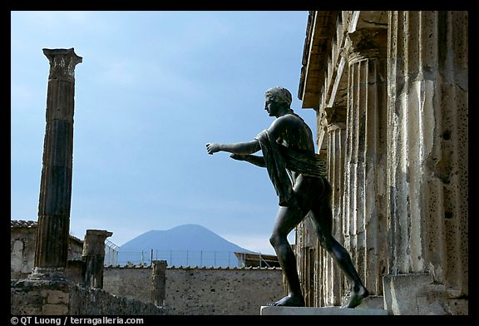
We can now see the Roman streets and statues of Pompeii that were buried 2000 years ago.

Slide 15
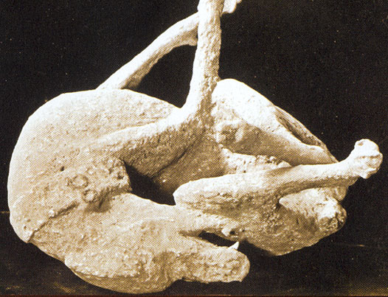
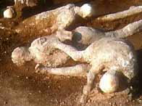
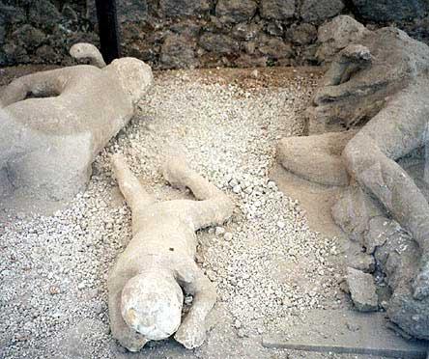
Archaeologists found imprints of bodies when they were digging. They made plaster casts of the body imprints. These are the people of Pompeii.

Slide 16
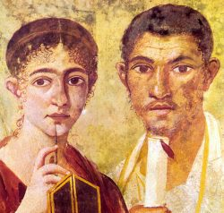
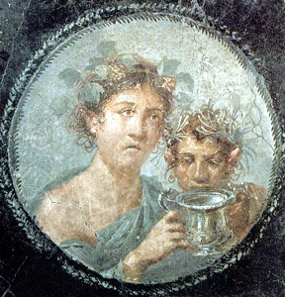
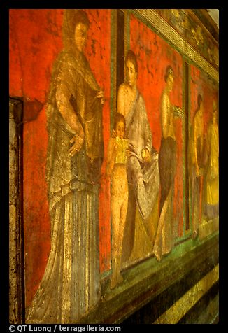
Archaeologists found lots of other things including mosaics, paintings and food!

Slide 17
Because of Pompeii we know a lot about life in Ancient Rome!
Next time we will be taking a virtual tour of Pompeii!

